Slide 1
Supervised Learning Final Project
by Rajdeep Mallick
Github Repo Link: https://github.com/RajdeepMallick21/Supervised_Learning_Final_Project_RajdeepMallick.git

Slide 2
Project Topic
The quality/ranking of wine will be predicted based on physiochemical components.
The wine quality will be ranked from 0 to 9
Appropriate ML models with a combination of hyperparameters will be used to predict on this dataset
If the accuracy, f1 score, auc score or other metrics provide good enough results, then this prediction model could be useful for wine sellers and customers to pick wines based on specific properties/characteristics.
The project will use KNN and Decision Tree models to perform Multi-class Classification tasks and predict the ranking of a wine based on its properties

Slide 3
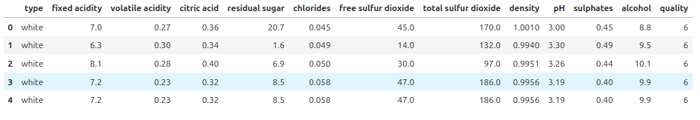
Info about the Data
This dataset was found on Kaggle.
It has 13 columns.
The 12 columns used for features are type, fixed acidity, volatile acidity, citric acidity, residual sugar, chlorides, free sulfur dioxide, total sulfur dioxide, density, pH, sulphates, alcohol.
The 1 column for target variable is called quality and it is the ranking of the wine.
First 5 rows of the dataset is shown below

Slide 4
Info about the Data
This dataset was found on Kaggle.
It has 13 columns.
The 12 columns used for features are type, fixed acidity, volatile acidity, citric acidity, residual sugar, chlorides, free sulfur dioxide, total sulfur dioxide, density, pH, sulphates, alcohol.
The 1 column for target variable is called quality and it is the ranking of the wine.
First 5 rows of the dataset is shown below

Slide 5
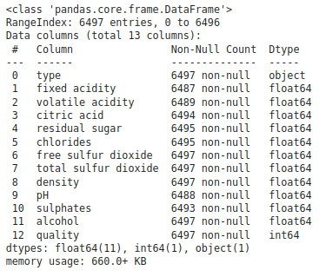
Info about the Data
The general shape of the dataset is 6497 rows and 13 columns.
There are some missing values as can be seen under Non-Null Count column
These will be cleaned up in the Data Cleaning section
The type column in the dataset has string object data type.
This will have to be converted to numerical value in the Data Cleaning section.

Slide 6
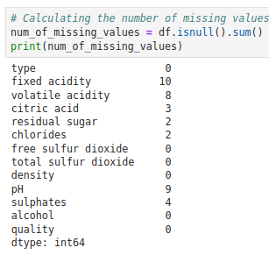
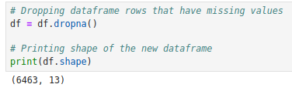
Data Cleaning
The sum of the missing values from every column was calculated here.
The rows with these missing values will have to be dropped from the dataset.
After dropping these rows, the final shape of the dataframe is 6463 rows and 13 columns

Slide 7
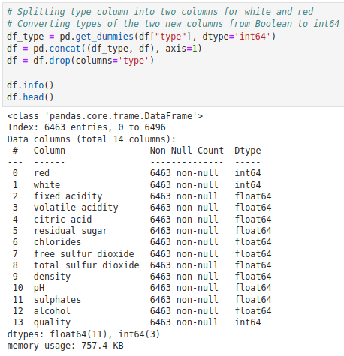
Data Cleaning
The type column had a data type of string object which will have to be changed.
It is a binary non-ordinal categorical variable.
The values have to be converted to 0 and 1.
The type column holds string values of ‘red’ and ‘white’.
Therefore, two indicator variable columns ‘red’ and ‘white’ with binary numerical values 1 and 0 will be created.
The original type column will be dropped since its no longer necessary.

Slide 8
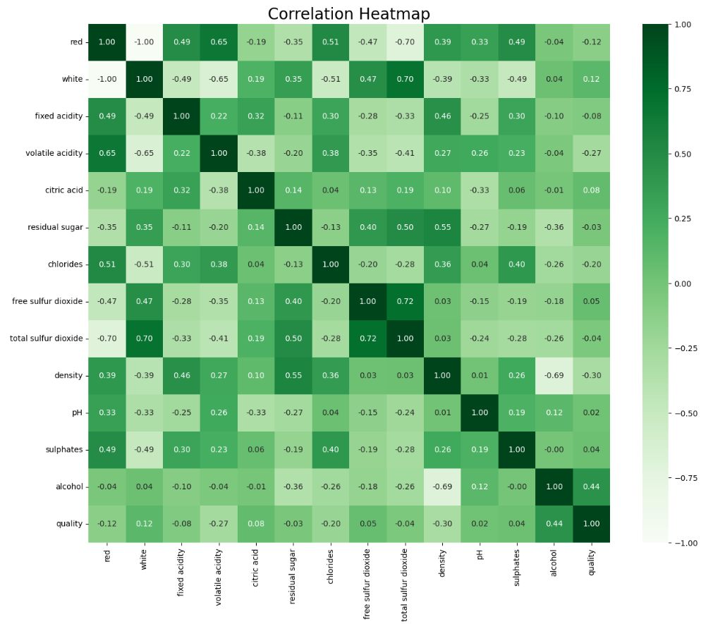
EDA
A correlation matrix was created to show the correlation between all columns.
The target variable quality has highest correlation with alcohol, density, chlorides and volatile acidity columns.
Density and alcohol had a high correlation of 0.69 which could indicate that they are linearly dependent and might have redundant info.
They will be checked for collinearity in the pairplot next

Slide 9
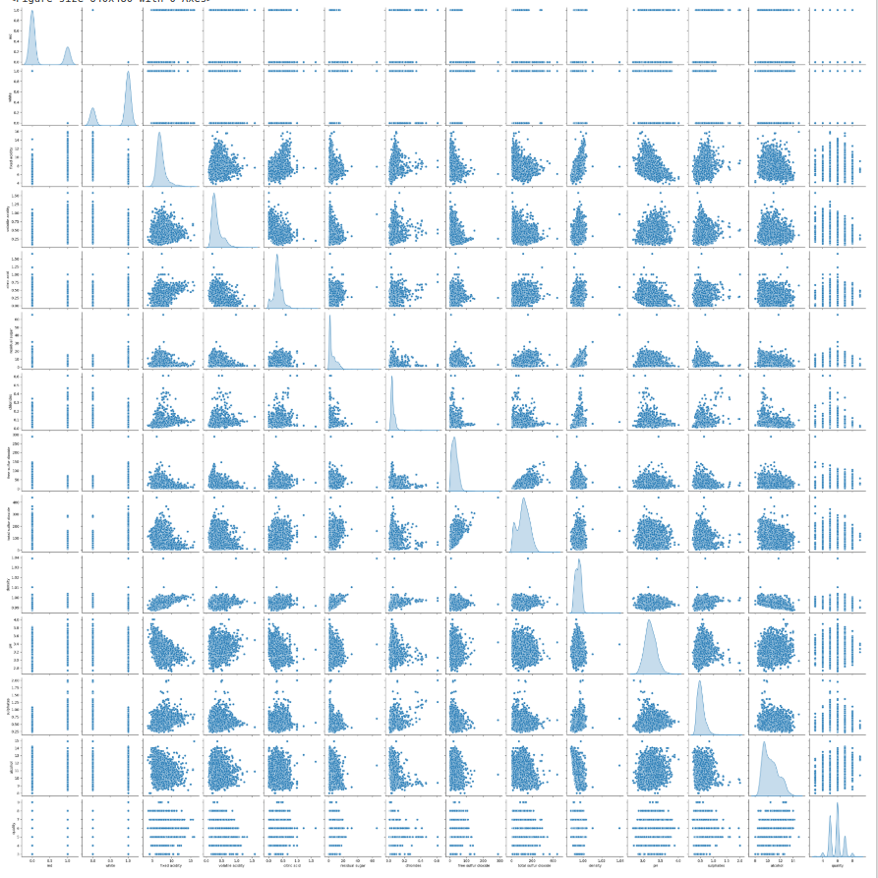
EDA
The scatterplot for density vs alcohol can be next to the red arrow.
The shape is not very thin or linear which could mean that these two features are not collinear.
Although, they could still be multicollinear which wouldn’t be identified by using pairplots and correlation matrix alone.
The vif value for each feature will be calculated next to check for multicollinearity.

Slide 10
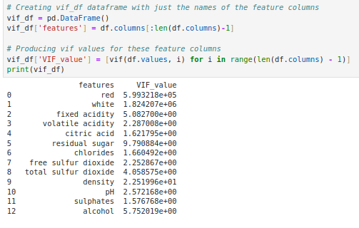
EDA
A vif dataframe was created here to show the feature names alongside their vif value.
In the lectures, any feature with vif of ‘inf’ or very high value was removed from the dataset.
Since all of the vif values are below 10, we can conclude that there is no multicollinearity between the features.
Therefore, no feature columns will be further removed from the dataset.

Slide 11
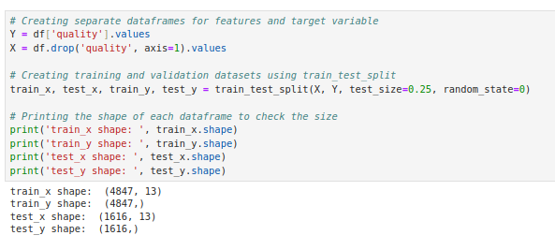
Preparing Data for Training Models
The columns for features and target variables were split into separate dataframes
These dataframes were then further split to create training and validation datasets.
The testing/validation datasets get 25% of the original data.
The shapes of these dataframes are shown.

Slide 12
KNN Model
Since there are only 13 features, the KNN classifier won’t suffer from curse of dimensionality.
There are an adequate amount of samples for the number of features/dimensions.
This should keep the accuray of the predictions high for this model.
BallTree was used to train the knn model with our training datasets and specific k values

Slide 13
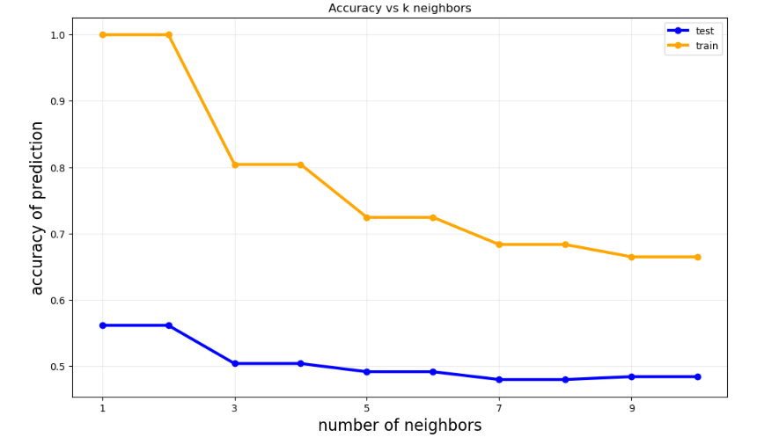
KNN Model Results and Analysis
The accuracy values with k neighbors of 1 to 10 were found for predicting on both the train and validation datasets.
The highest values for accuracy are at k=1 and k=2 for both.
Highest accuracy for train dataset is 1.0
Highest accuracy for test dataset is 0.56

Slide 14
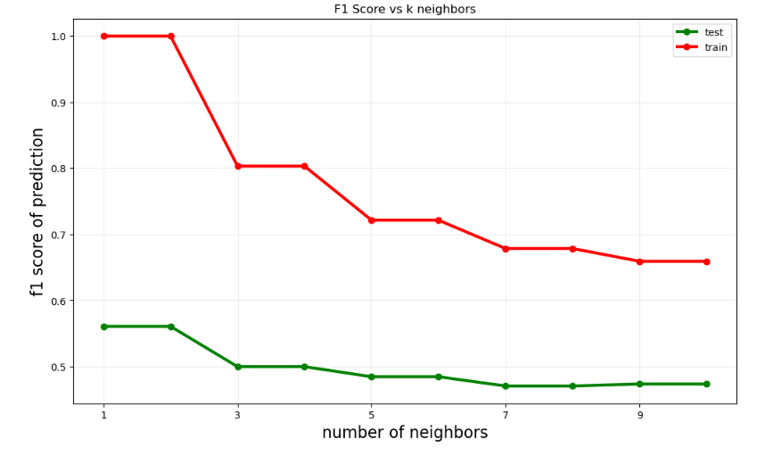
KNN Model Results and Analysis
Since precision and recall usually have a tradeoff, the F1 score was used as it captures both and is more robust.
F1 score was calculated for every k value from 1 to 10 for both datasets.
Best values were once again at k=1 and k=2.
Best F1 score for train dataset was 1.0
Best F1 score for test dataset was around 0.56

Slide 15
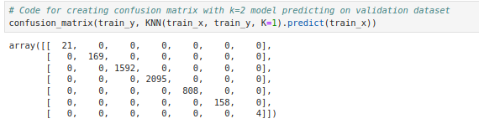
Discussion and Conclusion for KNN Model
Both the f1 score and the accuracy score curves of our KNN models produced similar results for k values ranging from 1 to 10.
The highest f1 and accuracy score for our validation dataset was 0.56 at k=2.
This is not a very high value and shows that the KNN model may need further tweaks or a different model may have to be used for this classification task.
In the description of the dataset it was mentioned that the labels were very imbalanced. This can be viewed in the confusion matrix for the k=1 KNN model below as the diagonal from top left to bottom right doesnt have too many values in every slot. This means that there are very low values for certain labels especially at the extremities. There are also no values for certain labels which is why the confusion matrix is not the right size. It is a 7x7 matrix when it should be a 10x10 matrix for quality/ranking scores of 0 to 9. The author of the dataset warns about this by saying that there are a lot of normal/average wines than bad or good wines.
Therefore, the dataset doesn't have enough data to accurately train the KNN model which would explain the poor results/predictions.

Slide 16
Decision Tree Model
For the decision tree models, hyperparameter tuning will be performed to produce the best results for accuracy scores.
The max_depth and min_samples_leaf hyperparameters will be determined using the GridSearchCV function from sklearn. This will also allow for cross validation. The input dataset will get split into chunks and the Decision Tree Classifier model will be fit to each of these chunks separately. The average of the accuracy scores from these fits will be determined. The best_estimator_ attribute will tell us which combination of these hyperparameters yielded the best average accuracy scores.
Decision Tree models tend to overfit to the data. To prevent this, pruning was performed by testing out different ccp_alphas values over a certain range. This will allow us to decide a value for this hyperparameter.

Slide 17
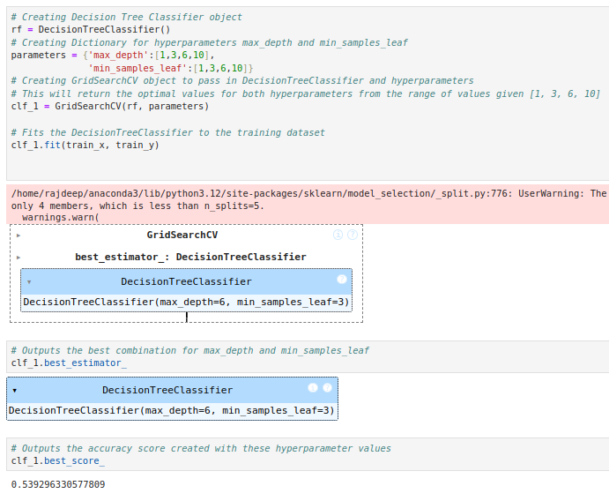
Results and Analysis for Decision Tree Model
Hyperparameter optimization using GridSearchCV() resulted in max_depth value of 6 and min_samples_leaf value of 3 as the best values chosen from the range of [1,3,6,10].
The accuracy for this best estimator was 0.539 on the training dataset.
This best accuracy score can be further improved when these two hyperparameters are combined with the ccp_alpha parameter which will be optimized next.

Slide 18
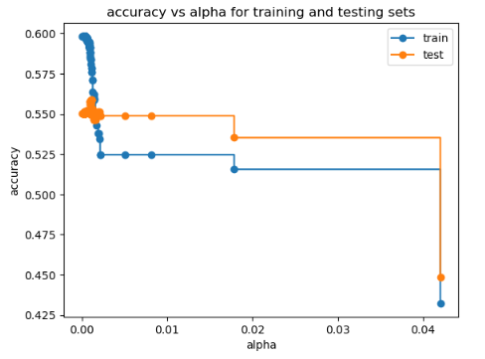
Results and Analysis for Decision Tree Model
The lowest ccp_alphas values produced the highest accuracy.
The highest accuracy value was 0.5983 for the train datset.
The ccp_alpha values that produced this highest accuracy value were 0.00015473 and 0.00016505.
Using these same ccp_alpha values for the test dataset produced accuracy value of 0.550124.
The best accuracy for the train dataset was therefore improved from 0.539 to 0.598 by adding ccp_alphas value alongside the max_depth and min_samples_leaf value found earlier.

Slide 19
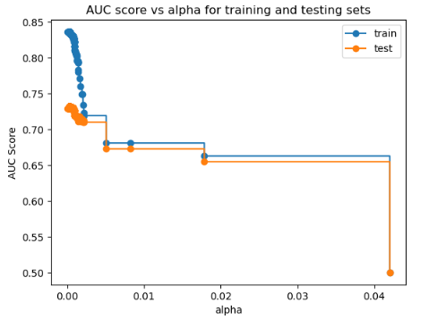
Results and Analysis for Decision Tree Model
Lowest ccp_alphas values produced the highest AUC score.
The highest AUC value was 0.8359 for the train datset.
The ccp_alpha values that produced this highest AUC value were 0.00015473 and 0.00016505 again.
Using these same ccp_alpha values for the test dataset produced AUC value of 0.729012.

Slide 20
Discussion and Conclusion for Decision Tree Model
The resulting best accuracy values from this model for the test datasets was 0.55 which is very close to the best accuracy value of 0.56 on the same dataset using k=2 KNN model.
The best train accuracy score dropped from 1 in the k=2 KNN model to 0.598 in our best Decision Tree model.
The introduction of the ccp_alpha hyperparameter improved the accuracy performance of the Decision Tree Classifier model compared to just using the max_depth and min_samples_leaf hyperparameters alone.
The accuracy improved from 0.539 to 0.598 for the train dataset.
The best ccp_alpha, max_depth and min_samples_leaf values for this model using this dataset are 0.0015473, 6 and 3 respectively.
The best values for train and test datasets were 0.8359 and 0.729 respectively which shows that there is a high True Positive to False Positive ratio produced by the best Decision Tree Models.

Slide 21
Conclusions Continued
The failure of two different models to produce accuracy values above 0.56 for the test dataset can also be due to there not being any features in the dataset that can predict the quality/ranking labels well.
This was suspected when the correlation matrix showed that none of the features had correlation values with the target variable above 0.7.
It could also be be due to there not being enough samples in the dataset.
This was indicated by the author of the dataset who mentioned that the labels were very imbalanced as there were not enough samples for very good or very bad wines but a lot of samples for normal/average ranked wines.
Ensembling methods such as Random forests, AdaBoost and Gradient Boost could improve the accuracy of the Decision Tree model by preventing overfitting.
Adjustment of more hyperparameters might yield better accuracy results in the future.

